Slide 1
LECTURE 10 Introduction to Graph

Slide 2
What you will learn in this lecture:
Structure of graph
Some terminologies and definitions
Some special graphs
Subgraphs
Adjacency matrix
The concept of a degree in a graph
The Handshaking Lemma

Slide 3
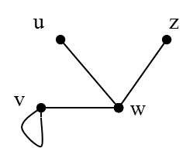
Graph
A graph is a very simple (and thus very general) data structure
Definition: A graph G = (V, E) consists of a set V of vertices (or nodes), together with a set E of edges which join two vertices.
For the above graph we have
Vertex set, V = {u, v, w, z}
Edge set, E = {uw, vw, zw, vv}
Thus G = ({u, v, w, z}, {uw, vw, zw, vv})
Note 1:
uw has the same meaning as wu
Note 2: If the edges are labelled, then the edges is written according to the label instead of the vertices endpoints.

Slide 4
Why are graphs important?
Where are graph used?
Networks are graphs:
Computer networks (computing grids, the internet)
Telephone networks
Social networks (who's friends with whom on Facebook), family trees, etceteras.
Transportation, shipping routes, roads, etceteras.
Usage in Computer science:
Dependency trees for software, pathfinding, optimisation, etceteras.

Slide 5
Some terminologies and definitions
Let G = (V, E)
An edge that connects a vertex back to itself is called a loop.
Two distinct edges with same set of vertices endpoints are said to be parallel.
Let v and w be vertices of G. If v and w are joined by an edge e, then v and w are said to be adjacent and e is said to be incident on v and w.
Two edges incident on the same endpoint are called adjacent.
A vertex that is an endpoint to a loop is called adjacent to itself.
A vertex with no edges are incident is called isolated.

Slide 6
Some terminologies and definitions
Example:
Consider the following graph:
Write the vertex set and the edge set, and give a table showing the edge-endpoint function.
Solution:
vertex set = {v1, v2, v3, v4, v5, v6}, edge set = {e1, e2, e3, e4, e5, e6, e7}

Slide 7
Some terminologies and definitions
Example (cont.):
b) Find all edges that are incident on v1, all vertices that are adjacent to v1, all edges that are adjacent to e1, all loops, all parallel edges, all vertices that are adjacent to themselves, and all isolated vertices.
Solution:
e1, e2, and e3 are incident on v1.
v2 and v3 are adjacent to v1.
e2, e3, and e4 are adjacent to e1.
e6 and e7 are loops.
e2 and e3 are parallel.
v5 and v6 are adjacent to themselves.
v4 is an isolated vertex.

Slide 8
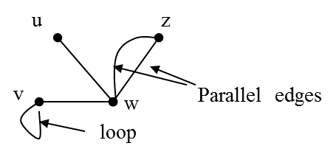
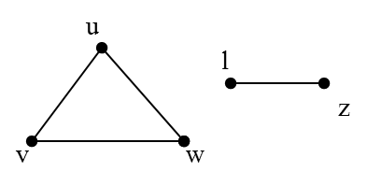
Some terminologies and definitions
A simple graph is a graph that does not have any loops or parallel edges
A graph is called connected if there is a path from any vertex to any other vertex, otherwise the graph is disconnected.
Example: a connected non simple graph:
Example: a disconnected simple graph:

Slide 9
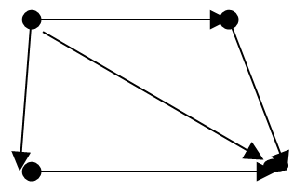
Directed graph
In a graph, an edge is joining 2 vertices but does not provide any information on how the vertices are connected (no direction). Therefore, there is a need for having directed graphs.
A directed graph (digraph) G = (V, E) consists of a set of vertices (or nodes) and a set of edges (or arcs) such that each edge e ∈ E
is associated with an ordered pair of vertices.
V = {a, b, c, d}, E = {ab, ac, ad, bd, cd}
a
b
c
d
Note: here we cannot write ab as ba because this is a digraph

Slide 10
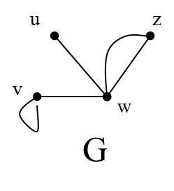
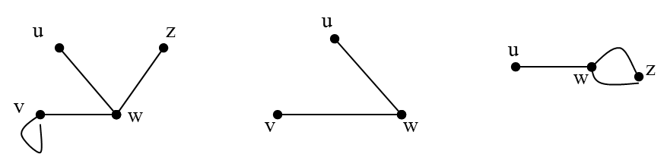

Subgraph
Let G be a graph with vertex set V and edge set E, a graph H is said to be a subgraph of G every vertex in H is also a vertex in G, every edge in H is also an edge in G and every edge in H has the same endpoints as it has in G.
Graph G
Example for subgraphs of G:

Slide 11
The concept of a degree in a graph
Let v be a vertex of a graph G, the degree of v, deg(v), equals to the number of edges that are incident on v.
An edge that is a loop will be counted twice towards the degree.
The total degree of G is the sum of the degree of all the vertices of G.
The Handshaking Lemma said that:
The sum of the degrees of all vertices of G equals twice the
number of edges of G.

Slide 12
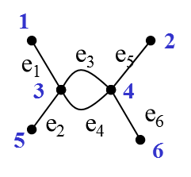
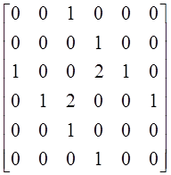
Adjacency matrix
Let G be a graph with n vertices labeled 1,2,3,…,n. The adjacency matrix A_{G} is the n x n matrix in which the entry in row i and column j is the number of edges joining the vertices i and j.
Example:
M Adjacency matrix of M

Slide 13
Exercise
Find the adjacency matrix for G
y

Slide 14
Example
Find the degree of each of the vertex in G and also the degree of G
Verify if the handshaking lemma holds for G.
y

Slide 15
Summary
Materials covered in this lecture?
The structure of graph
Some important terminologies related to graph
Some special graphs
The concept of degree
The handshaking lemma
The adjacency matrix

Slide 16
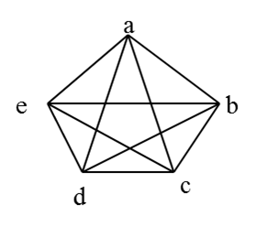
Exercise 1
What is the adjacency matrix for this graph?

Slide 17
Exercise 2
1) How many edges are there in a graph with 10 vertices each of degree 6?
2) Is there a graph with the degrees of vertices 1, 1, 1, 4?

